Slide 1


Blended Learning Plan

Slide 2
Context
During the national lockdown the staff at Ebor Gardens & Victoria Primary Academies setup and populated the Google Classrooms swiftly. During this time, Paper Packs were also produced and delivered to learners who could not access learning digitally. As expertise around the Google Classroom develops, staff will continually review and improve the online provision offered to children who cannot access learning in school.
In preparation for any further lockdowns or ‘bubbles’ burst which would result in home learning, we have blended our curriculum onto the Google Classroom; furthermore, our Paper Packs provide the children with everything possible to learn from home without access to digital devices.
In September 2020, we carried out a survey with families to find out which children had no access to their own digital device or to a fixed internet connection. Wellspring Academy Trust will request our allocation of devices due to digital deprivation.

Slide 3
Introduction
It is important that we are fully prepared for the possibility that we may have to have a full or partial closure of school depending on the local COVID-19 situation. In the event of children having to self-isolate and school closure, be it short term or long term, staff at Ebor Gardens & Victoria Primary Academies will continue to provide education and support to our pupils, using in-school teaching, remote learning and/or a combination of both. Depending on the circumstances, learning will be conducted using in-school teaching and learning, Google Classroom, EAZMAG (Foundation Stage) and Dojo apps. In some circumstances we may use educational resource packs.
Our detailed plans for remote education ensure that the needs of all pupils are catered for and allow for staff to keep in daily contact and provide a two-way platform for learning and teaching, in a professional and confidential manner with each pupil in their class. Teachers will be able to schedule learning in a manner that does not overwhelm or concern our pupils. Teaching and learning can be tailored, changed and updated as time progresses, in-line with government guidelines, allowing for replication of classroom activities. As part of this, the Continuum of Blended Learning will be embedded. In all communications we will adhere to our commitment to maintaining pupil wellbeing.

Slide 4
Key Principles
We are committed to six underlying principles, which underpin our remote education plans:
Safeguarding pupils from harm, online and offline, remains the key priority.
Pupils will continue to be taught a well-sequenced curriculum.
Teachers will continue to set work that scaffolds pupils’ practice and helps them to apply their new learning.
Pupils will continue to receive feedback that helps them to make progress.
No child should be disadvantaged by a lack of technology at home.
Remote education plans should not place unreasonable demands on parents’ help or support, or the workload of teachers.
In order to deliver remote education, the school has adopted a continuum of blended learning, taking into account the different reasons pupils may be absent: individual self-isolating; bubble of year group closure; whole school closure.

Slide 5
Flexibility
It is important that children engage with the remote learning, however, we realise that the circumstances that cause our school to adopt a ‘blended learning’ approach will affect families in a number of ways.
In our planning and expectations we are aware of the need for flexibility from all sides: parents may be trying to work from home and so access to technology as a family may be limited; teachers may be trying to manage their home situation and the learning of their own children, or the effective planning for both in-school and remote learning opportunities; systems may not always function as they should.
An understanding of, and willingness to adapt to these difficulties on all sides, is essential for success.
Children’s access to technology is ascertained and those who are digitally disadvantaged will be able to loan equipment from school (a loan agreement will be in place for this).

Slide 6
Expectations
In the case of closure we believe that it is in the best interests of our pupils that we continue to provide structured support to the best of our ability. The work that pupils engage in during a period of closure, or as part of the ‘blended learning’ approach, will be part of our current planning and so cannot be considered as optional. Pupils and parents should consider the arrangements as set out in this document as highly recommended.
Teaching staff will expect to receive set work/assignments within the specified timeframe. Should families encounter any difficulties with this arrangement, they must be discussed with the child’s class teacher in the first instance.
Teaching staff will…
• Place significant emphasis on pastoral development within the classroom.
• Prepare weekly resources via Google Classroom to meet the needs of each child.
• Share teaching and learning activities with their class through Google Classroom.
• Continue providing work and support in line with current, extensive planning that is already in place throughout the school.
• Give weight to the fact that learning remotely will be more difficult, so tasks will be shortened and supported in smaller steps to allow for this.
• Ensure at least weekly contact with pupils where possible (in line with pastoral plan) either by telephone or through Google Classrooms.
• Set work and give feedback on learning/activities.
• Inform the Head of School if unwell and ensure cover by another staff member.

Slide 7
Expectations
Non-teaching Staff will…
• Support class teacher in preparation of paper packs/activities where required
• Support, where necessary, individual/small groups of pupils by providing tailored activities which can either be used in school or when learning at home.
• Have access through Google Classroom apps to support remote learning.
• Ensure their communications have been shared with the class teacher and/or SENCO.

Slide 8
What will it look like?
Scenario 1: Your child is in school on a normal school day
Google Classroom/Remote Learning | Instructional Videos/New Learning | Homework
Children will use this in school to access some resources and complete some work using google documents, forms and other applications. | N/A | This will be set and submitted on Google Classrooms. In addition, there may be some project or non-screen based work. Children who are unable to access the Google classroom will be provided with a paper copy of any home learning.

Slide 9
What will it look like?
Scenario 2: Your child is self-isolating but the rest of their class is in school
Google Classroom/Remote Learning | Instructional Videos/New Learning | Homework
You will be able to access all of the learning that your child would have in school. Use the “classwork” section to access daily activities with instructions. This will be updated regularly and work will be available between Monday and Friday each week. Children with no access to Google Classroom will be provided with a paper pack of the learning. | The class teacher will record instructional videos to help with your child’s new learning at home and they will upload reliable teaching videos for new learning. There will be a minimum hour of new learning. | This will be set and submitted on Google Classrooms. In addition, there may be some project or non-screen based work. Children who are unable to access the Google classroom will be provided with a paper copy of any home learning.

Slide 10
What will it look like?
Scenario 3: Bubble closure, as advised by PHE (whole class/phase at home)
Google Classroom/Remote Learning | Instructional Videos | Homework
You will be able to access all of the learning that your child would have in school. Use the “classwork” section to access daily activities with instructions. This will be updated regularly and work will be available between Monday and Friday each week. Children with no access to Google Classroom will be provided with a paper pack of the learning. | Your child will have daily contact with their teacher via e-mail. The class teacher will record instructional videos to help with your child’s new learning at home and they will upload reliable teaching videos for new learning. There will be a minimum hour of new learning. Each child will be contacted by telephone once a week. Some children will be contacted more frequently as required. | n/a

Slide 11
What will it look like?
Scenario 4: The academy has been closed.
Google Classroom/Remote Learning | Instructional Videos | Homework
You will be able to access all of the learning that your child would have in school. Use the “classwork” section to access daily activities with instructions. This will be updated regularly and work will be available between Monday and Friday each week. Children with no access to Google Classroom will be provided with a paper pack of the learning. | Your child will have daily contact with their teacher via e-mail. The class teacher will record instructional videos to help with your child’s new learning at home and they will upload reliable teaching videos for new learning. There will be a minimum hour of new learning. Each child will be contacted by telephone once a week. Some children will be contacted more frequently as required. | n/a

Slide 12

Online Learning Curriculum
Each phase will populate the Google Classroom with activities for each week in advance.
- Daily phonics/spelling
- Daily reading
- Daily writing
- Daily Maths
- Daily topic session (foundation subjects) in line with school curriculum coverage.
Each new concept will have an instructional video from the teacher or a quality assured external video (for example, Oak National or other quality remote providers) on the Google Classroom. This will provide a minimum of one hour of new learning per day.
Staff will also upload relevant videos or links to Google Classroom using platforms such as BBC Bitesize. platforms currently under subscription - such as TT Rockstars, ‘Bug Club’ and FrogPlay - will also be linked on the Google Classroom.

Slide 13
Online Learning Curriculum
Every new concept should include an assessment of student understanding. This may be using Google Quiz and/or platforms such as Kahoot, embedded into the Google Classroom. Results of this will be used for whole class assessment to identify and correct misconceptions and inform future planning.
Writing activities include the relevant year group targets so that children are aware of them. Each piece of written work will be marked against these targets by a staff member. Individual targets will be shared so that children know what they need to achieve in their next write. This will also address misconception.

Slide 14

Celebrating Success
Reward systems from the policy should continue as normal while the children work from home.
Dojo points should be given daily (as normal) for work completed. The teacher will log the points on the Class dojo website as usual.
The ‘Star of the Week’ award will be given to one pupil per class, each week, as usual.
The ‘Ebor Ethos’ award will be given to one pupil per class, each week, as usual.
Two ‘Top Spots’ (writing award) will be given each week and their work displayed on the Google Classroom.

Slide 15
Pupils with SEND
For pupils with SEND, their teachers are best-placed to know how the pupils needs can be most effectively met to ensure that they continue to make progress even in they are not able to be in school due to self-isolating. The requirement for schools to provide provision for pupils with SEND, remains in place.
We will work collaboratively with families, putting in place reasonable adjustments as necessary, so that pupils with SEND can successfully access remote education alongside their peers.
Where a pupil has provision specified in their EHC plan, it remains the duty of the local authority and any health bodies to secure or arrange the delivery of this in the setting that the plan names. However, there may be times when it becomes very difficult to do so, for example, if they are self-isolating. In t his situation, decisions on how provision can be delivered should be informed by relevant considerations including, for example, the types of services that the pupil can access remotely, for example, on line teaching and remote sessions with different types of therapists. These decision will be considered on a case by case basis, avoiding a one size fits all approach.

Slide 16
Monitoring Engagement with remote learning
Teaching teams will monitor and record engagement with Google Classroom. Teaching teams will also have a schedule of contact, to ensure regular contact is made with a child who is not in school due to COVID-19 isolation or exposure. These calls will provide an opportunity for teaching teams to provide support with online learning, where required.
Pupil Isolating (symptomatic – 10 days)
Teaching Team Contact Day:
Day 1 | Day 4 | Day 7
First day contact. Established device access/access to Google Classroom. Signpost to activities on Google Classroom. | Follow-up contact | Follow-up contact Discussion around return to school.

Slide 17
Monitoring Engagement with remote learning
Pupil Isolating (exposure – 14 days)
Teaching Team Contact Day:
Day 1 | Day 4 | Day 7 | Day 12
First day contact. Established device access/access to Google Classroom. Signpost to activities on Google Classroom. | Follow-up contact | Follow-up contact | Follow-up contact Discussion around return to school.

Slide 18
Monitoring Engagement with remote learning
Bubble Closure (exposure – 14 days)
Teaching Team Contact Day:
Day 1 | Day 4 | Day 7 | Day 12
First day contact. Established device access/access to Google Classroom. Signpost to activities on Google Classroom. | Follow-up contact | Follow-up contact | Follow-up contact Discussion around return to school.

Slide 19
Vulnerable Children
Where individuals who are self-isolating are within our definition of vulnerable, we have robust systems in place to keep in contact with them. When a vulnerable child is asked to self-isolate, we will notify their social worker (if they have one). School leaders will then agree with the social worker the best way to maintain contact and offer support to the vulnerable child or young person.
We will check if a vulnerable child is able to access remote education. Where this is not the case, we will support them to access it (as far as possible) and the regularly check if they are doing so. We will ensure that the teaching and learning offered to pupils, but especially our most vulnerable pupils, secures their interest and engagement.

Slide 20
Safeguarding Considerations
At Ebor Gardens & Victoria Primary Academies we are committed to the safeguarding of all pupils. It is important that all staff who interact with children, including online, continue to look out for signs a child may be at risk. Any such concerns should be dealt with as per the Child Protection Policy and, where appropriate, referrals should still be made to children's social care and as required, the police.
Regular contact will be maintained with our children and families through periods of absence from school. Where contact cannot be made through phone calls home, home visits will take place.

Slide 21
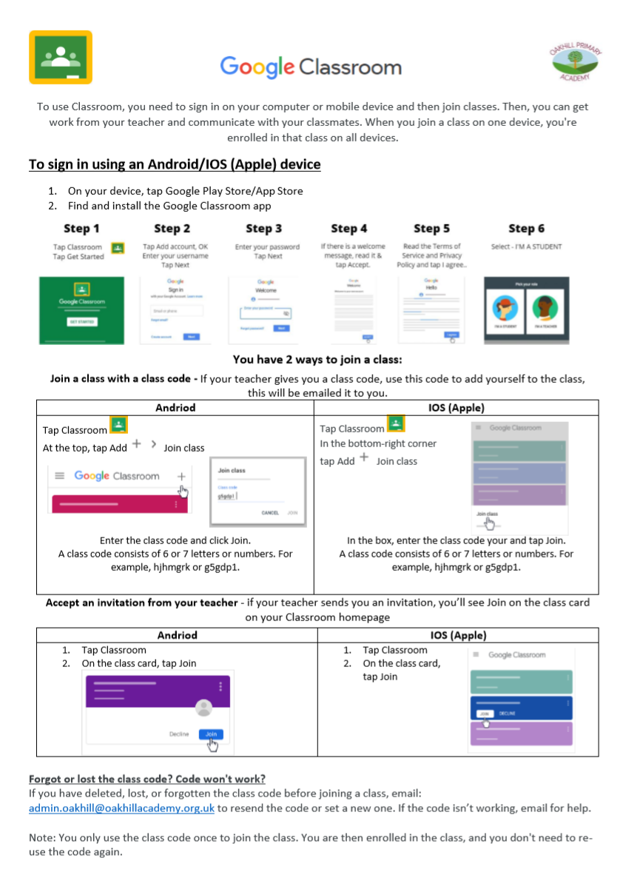

Using Google Classroom

Slide 22

Staying Safe Online
Other useful websites/organisations:
https://www.thinkuknow.co.uk/
https://www.nspcc.org.uk/keeping-children-safe/online-safety/

Slide 23
If you require any further support with online learning please do not hesitate to get in contact with us
PHONE: 0113 248 2750 (Ebor Gardens)
Or
FACEBOOK: Message us via Facebook messenger
Or
EMAIL: Email us through the Admin inbox at: admin@eborgardensacademy.co.uk

Slide 24
Quality Assurance
Requirements | Findings | Requirements | Findings
Daily Maths activities (including arithmetic) |  | Links to other platforms (TT Rockstars, Bug Club, BBC Bitesize)
Daily SPaG activities |  | Topic activities
Daily reading activities |  | Assessment activities for new concepts
Daily Phonics activities |  | Feedback to address misconceptions
Weekly Spellings |  | Awards given weekly
Writing tasks |  | Amount of children accessing classroom
Instructional Videos for new concepts

