Slide 1
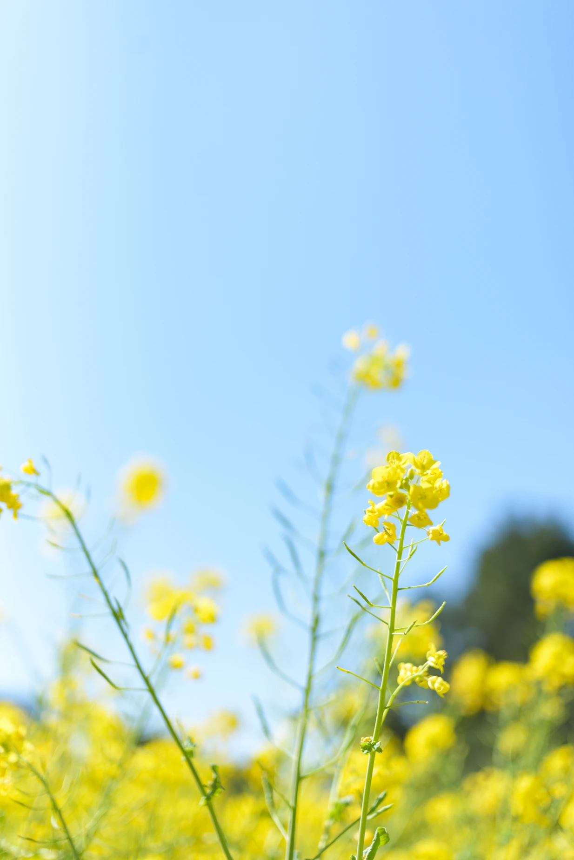
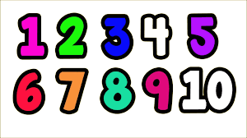
Nursery Summer 1 News
We will be learning…
Maths |  | Phonics
In maths, our focus is to complete inset puzzles and use comparison language – bigger/little/smaller, high/low, tall, heavy. Our little stars will be able to solve real world problems with numbers up to 5. |  | In phonics our focus is oral blending and alliteration, children will try to identify couplets and will be introduced to CVC words.
Science | RE/Our world |  | Topic
In Science, we will be discussing about changes and seasons and play some fun games with light and shadows. | We will be discussing about ways to support others and how we can talk about ourselves in a positive manner. Children will discuss their dreams and aspirations. |  | Summer 1 half term is packed with lots of fantastic learning opportunities! Our topic is “Pets,pets,pets” and we will organise at the end of the term an outdoor picnic day!
Art | Writing |  | PE
In Art we will create a collage using different materials with pattern and texture. Children will discuss how the colours and patterns make them feel. Our Artist of the term is Romero Britto! | In writing, we will continue with mark making and name writing. |  | Nursery PE is Friday. Please remember to come to school wearing suitable clothing for the everchanging weather.
We will be encouraging the children to read every day. Please listen to your children read at home or access Bug Club.
Adults at Home: We need YOU!
.
We will be encouraging the children to read every day alongside a grown up in our setting. Please read with your child at home every day, if possible.
Tapestry is an online journal to help record all the learning and fun of children's early years education. Log in to see some of your child`s special moments during the week.
Tapestry
Early Bird
Name writing
When you arrive at school you will find your writing book and practise your name daily.
You can contact us via info@vpaleeds.co.uk and follow us on Facebook and Twitter for regular updates!

