Slide 1
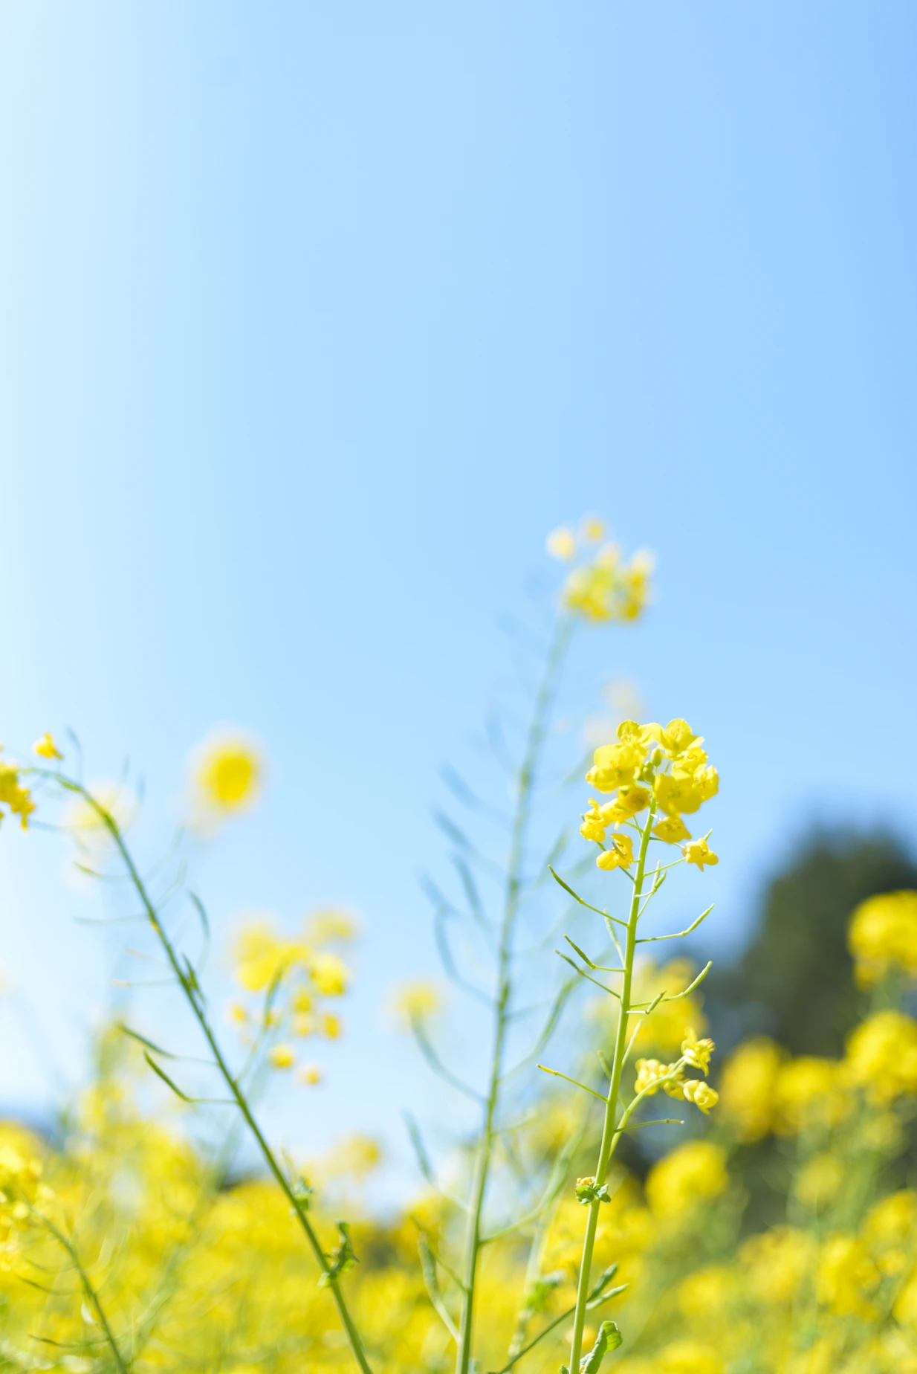
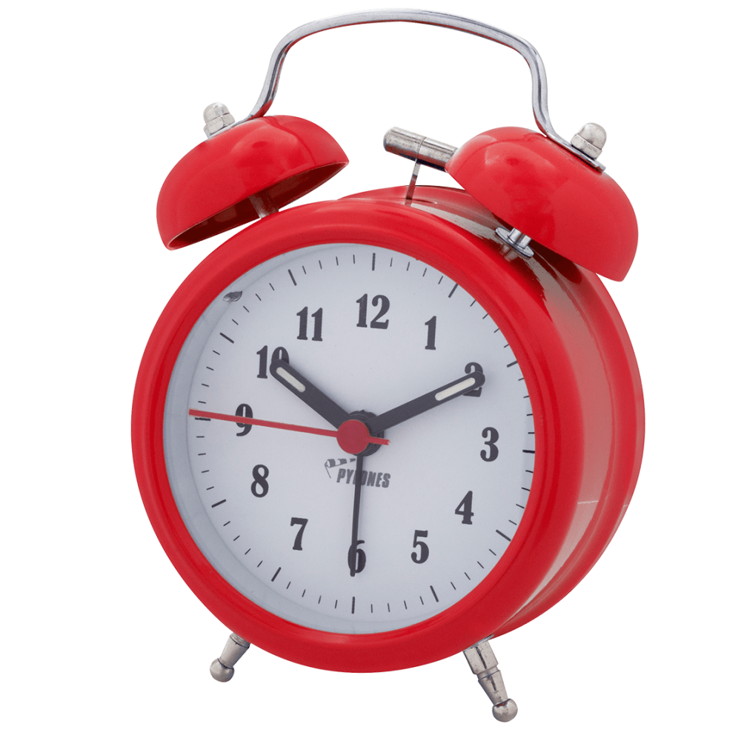
Nursery Summer 2 News
We will be learning…
Maths |  | Phonics
This term we will solve number problems and we will be able to identify our own mathematical problems based on our own interests during play. |  | In phonics our focus is oral blending and alliteration, children will try to identify couplets and will be introduced to CVC words.
Science | RE/Our world |  | Topic
We will investigate the difference between floating and sinking. Children will make a pirate ship by exploring different materials to see what floats and sinks. | Children will make a pirate ship using a wide range of materials e.g., plastic bottles, string, lollipop sticks etc. They will test their models when built and use a fan to propel the ships to see which travel faster. |  | Summer 2 half term is packed with lots of fantastic learning opportunities! Our topic is “Oh I do like to be beside the seaside” , and we can't wait to start our adventures!
Art | Writing |  | PE
In Art we will become little artists and create our own masterpieces made with watercolors . We will get inspired by the artist of the term Georgia O`keeffe! | In writing, we will continue with mark making and name writing. Also, we will start writing some CVC words. |  | Nursery PE is Friday. Please remember to come to school wearing suitable clothing for the everchanging weather.
We will be encouraging the children to read every day. Please listen to your children read at home or access Bug Club.
Adults at Home: We need YOU!
.
We will be encouraging the children to read every day alongside a grown up in our setting. Please read with your child at home every day, if possible.
rf
Important Dates!
Early Bird
July 9-10 ^{th} :Transition Days
Name writing
When you arrive at school you will find your writing book and practise your name daily.
You can contact us via info@vpaleeds.co.uk and follow us on Facebook and Twitter
for regular updates!

